Slide 1
Physician Workforce Supply and Demand in Nevada
John Packham, PhD
Office of Statewide Initiatives
University of Nevada, Reno School of Medicine
October 3, 2017

Slide 2
Overview
Health workforce demand and supply in Nevada
Recent GME completion and retention trends in Nevada
Current physician workforce supply by specialty and county in Nevada and the US

Slide 3
Forces Driving Physician Workforce Demand
Primary Factors
Population growth and aging
Reform-related insurance coverage expansions
GDP and income growth, e.g., Tesla effects
Important, but Secondary Factors
Population health needs (demand ≠ need)
Non-physician practitioners, esp. APRNs
Health care system change, e.g., industry consolidation
Technological change, e.g., telehealth
Notes:
I’d like to begin our discussion of health workforce demand in Nevada by mentioning the principal factors driving demand for health services and health professionals. The principal drivers are population growth and aging, insurance coverage expansions associated with national health reform, and economic growth.
Secondary drivers include the health needs of our state, changes in the way health care is delivered, and finally changes in technology such as telehealth that affect the demand for care and workers. At the end of the day, population growth, population aging, and an improving economy will drive above average demand for health care and health workers over the next five to ten years.

Slide 4
Health Care Employment in Nevada Number of Jobs (Thousands) – 2006 to 2017
Source: Nevada Department of Employment, Training, and Rehabilitation (2017).
Notes:
This slides shows a snapshot of health care employment in Nevada over the past decade. The lines indicate steady growth in health care employment in Nevada – growth that was essentially uninterrupted by the Great Recession represented by the shaded portion of each graph. The numbers are January from year to June of current year.
One month lag for Las Vegas. Matches with Estimated Employment in Nevada using the one month lag to match data.
NVEmp in excel master file data is from the DETR query CES, NAICS code 2 and 3 digits, 65620000, 65621000, 65622000, not seasonally adjusted will do only Nevada and Las Vegas due to suppression of Reno-Sparks data, last updated August 2016

Slide 5
Health Care Employment in Las Vegas Number of Jobs (Thousands) – 2006 to 2017
Source: Nevada Department of Employment, Training, and Rehabilitation (2017).
Notes:
This slide shows a snapshot of health care employment in Las Vegas over the past decade. The steady growth in health care employment in Las Vegas is striking because this growth that was essentially uninterrupted by the Great Recession represented by the shaded portion of each graph, contrary to almost every other sector in the community. The numbers are January from year to June of current year.
one month lag for Las Vegas.
LVEmp in excel master file data is from the DETR query CES, NAICS code 3 digits, will do only Nevada and Las Vegas (one month lag for Las Vegas) due to suppression of Reno-Sparks data, data through June 2016, last updated 8/20/16.

Slide 6
Demand for Health Professionals in Nevada Total Health Sector Job Postings – 2014 to 2016
Source: OSI analysis of Burning Glass, Copyright © 2017 Burning Glass Technologies.
Notes:
Ongoing increases in job postings in ambulatory care, hospitals, and nursing homes in Nevada. Does not include health care occupations employed in other industries which charts 26-28 display.
NVHlthSector tab in excel master. Use Burning Glass-Labor Insight queries for slides using job posting data, slides 9-42, data may change from data of query to when query is run again, last run 8/22/2016
Query criteria is top industries, select location (Nevada), industry, (health care and social assistance)

Slide 7
Demand for Physicians in Nevada Job Postings – from 2014 to 2016
Source: OSI analysis of Burning Glass, Copyright © 2017 Burning Glass Technologies.
Notes:
Demand for physicians points out that not all physicians work in the health sector, as 23.7% job postings are in non health care industries.
NVPhysHC&not data in excel spreadsheet.
This job posting query used industry sector equal to health care and social assistance or not equal to health care and social assistance. Use Burning Glass-Labor Insight queries for slides using job posting data, slides 9-42, data may change from data of query to when query is run again, last run 8/22/2016
Select year (2013) select location ( State : Nevada ) AND ( SOC : Anesthesiologists (29-1061) OR SOC : Family and General Practitioners (29-1062) OR SOC : Internists, General (29-1063) OR SOC : Obstetricians and Gynecologists (29-1064) OR SOC : Pediatricians, General (29-1065) OR SOC : Psychiatrists (29-1066) OR SOC : Surgeons (29-1067) OR SOC : Physicians and Surgeons, All Other (29-1069) )
Select sector on additional queries for ( Industry Sector : Health Care and Social Assistance )

Slide 8
Projected Demand for Health Care Workers by Industry in Nevada from 2014 to 2024
Total Health Care and Social Assistance Sector:
+ 27,991 jobs (+25.1%)
Ambulatory Care: 13,987 jobs (+30.2%)
Offices of physicians: 6,390 jobs (+35.6%)
Offices of dentists: 1,052 jobs (+13.3%)
Hospitals: 4,152 jobs (+12.3%)
Skilled Nursing Facilities: 3,484 jobs (+27.2%)
Source: Nevada Department of Employment, Training, and Rehabilitation (2016).
Notes:
This slide summarizes employment projections developed by the Nevada Department of Employment, Training and Rehabilitation through 2022 (to be updated soon). This data reveals steady overall growth in employment in the health sector – nearly 18,000 jobs or 16 percent over the decade – as well as double-digit percentage growth in every health industry within the sector.
I’m pretty confident that the next iteration of DETR projections – for the period 2014 to 2024 – are likely to show even stronger projected grown across the health sector.
Table3NVProj
Not posted online (Nevada Workforce Informer) as of August 23, 2016. DETR query details are in Table3NVProj tab of excel spreadsheet

Slide 9
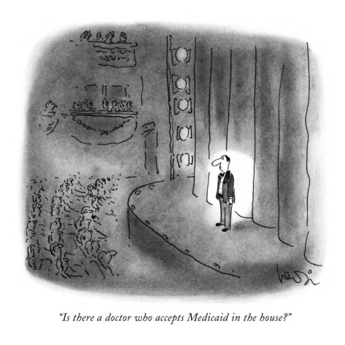

Slide 10
Physician Workforce Supply in Nevada
Steady growth in the number of physicians (MD & DO) across most areas of the state
“Treading water” in the number of licensed physicians and other health professionals per capita (with some important exceptions)
Severe shortages compounded by an improving economy, ACA-related demand, and an aging health workforce
Persistent specialty shortages and geographic maldistribution of physicians and providers

Slide 11
Current Physician Workforce Rankings Number of Active Licensees in Nevada per 100,000 Population
Physicians, MDs – 47th among U.S. states
Physicians, DOs – 18th
Physicians, MD & DO – 48th
Patient Care Physicians – 48th
Primary Care Physicians – 50th
Residents & Fellows – 47th
Residents & Fellows in Primary Care – 48th
Source: Area Health Research File (AHRF) (2016).
Notes:
AAMC and Area Health Resource File tables. AHRF allow for per capita calculations, sorting, and ranking using all 50 states data.

Slide 12
Current Physician Workforce Rankings Number of Active Licensees in Nevada per 100,000 Population
Anesthesiology – 23rd
General and Family Practitioners – 47th
General Surgeons – 50th
Internal Medicine – 30th
Obstetricians and Gynecologists – 47th
Orthopedic Surgeons – 51st
Pediatricians – 48th
Psychiatry – 47th
Source: Area Health Research File (AHRF) (2016).
Notes:
AAMC and Area Health Resource File tables. AHRF allow for per capita calculations, sorting, and ranking using all 50 states data.

Slide 13
Number of Licensed Allopathic Physicians (MDs) per 100,000 Population in Nevada – 2006 to 2016
Source: OSI analysis of unpublished data from Nevada State Board of Medical Examiners (2017).
Notes:
The next three slides highlight changes in the number of allopathic physicians and RNs in Nevada over the past decade. While we are near the bottom of state rankings for both professions, we’ve actually made substantial progress in increasing both the number and per capita number of MDs and RNs, particularly the latter.
These slides also highlight ongoing or persistent regional differences. Clark County rates represented by the green line in each figure lie closely to the state average represented by the black line. And, per capita rates for northern Nevada are typically higher than the south (the blue line) and rural rates or trends represented by the red line lie well below state and urban trends.
NV MDsPer100K tab in excel spreadsheet.
Data is available for 2016, needs to be calculated into these categories. 8/24/16.

Slide 14
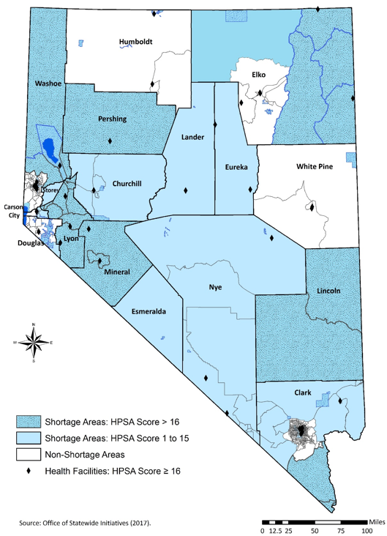
Primary Care Health Professional Shortage Areas (HPSAs) – 2017
982,117 Nevadans reside in a primary care HPSA (33.7%)
836,216 urban residents in Nevada (31.8% of urban residents) live in a primary care HPSA, including 631,812 residents of Clark County
165,412 rural residents (49.8% of rural residents) live in a primary care HPSA
9 single-county primary care HPSAs
Notes:
Our discussion of health workforce supply will conclude with a look at current health professional shortage areas or HPSAs in Nevada and our estimates for the number and percent of Nevadans residing in primary care HPSAs, dental HPSAs, and mental health HPSAs. In Slides 25 through 27, the shaded areas representing shortage areas and the white or blank areas of each map representing non-shortage areas.
Most counties are characterized primary care health professional shortages The white areas mean non-shortage areas which can be misleading when the loss of one physician can turn an area from non-shortage to shortage. Statewide, one in three Nevadans currently living in a shortage area statewide; however, we should not that one in two in rural Nevadans are living in a shortage area.

Slide 15
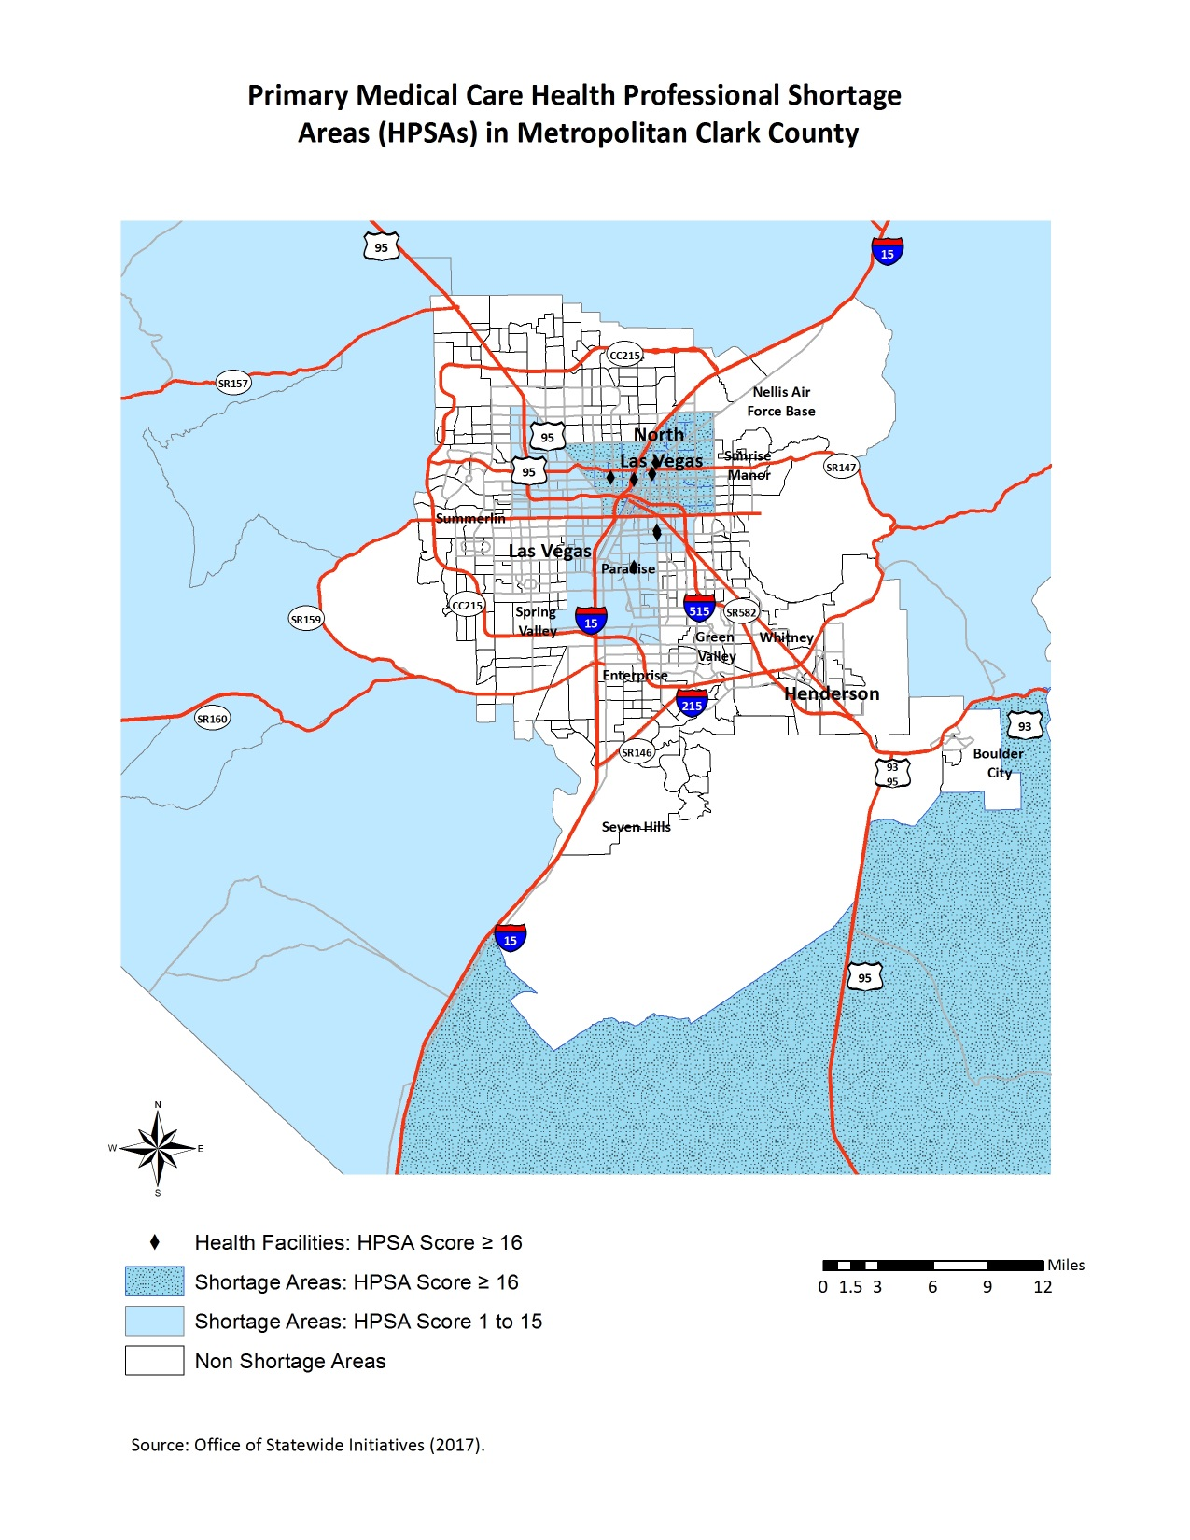
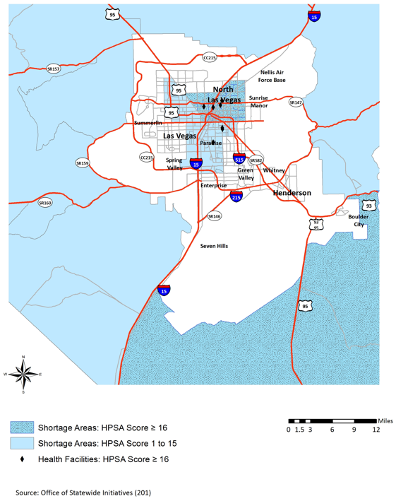

Slide 16
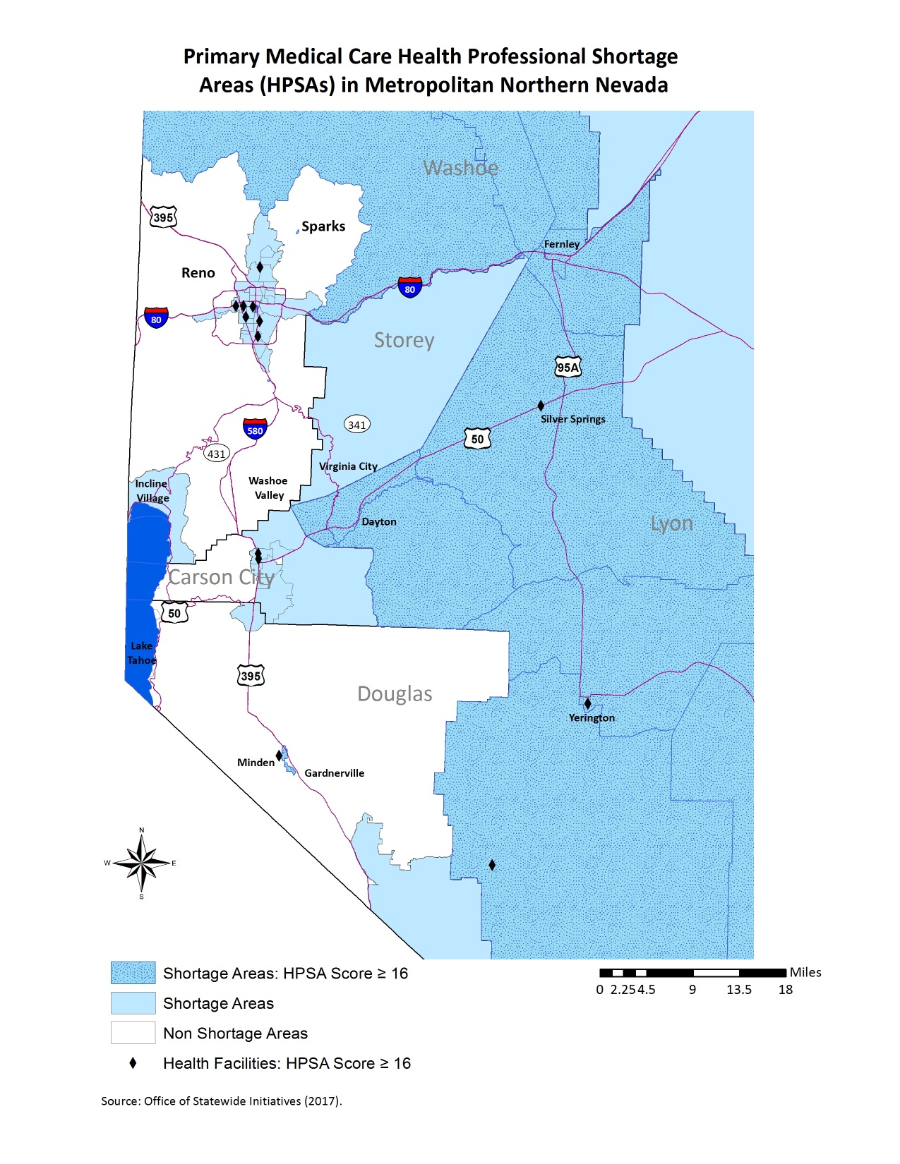
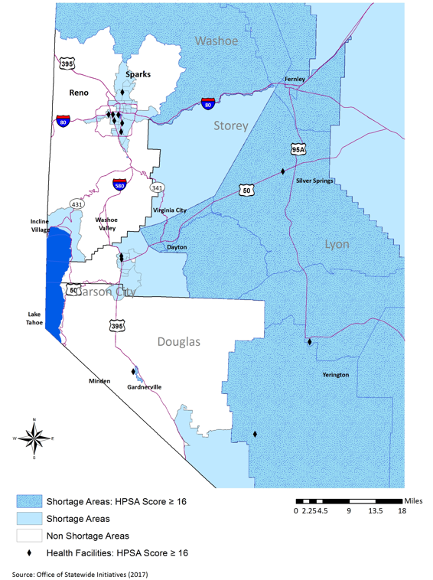

Slide 17
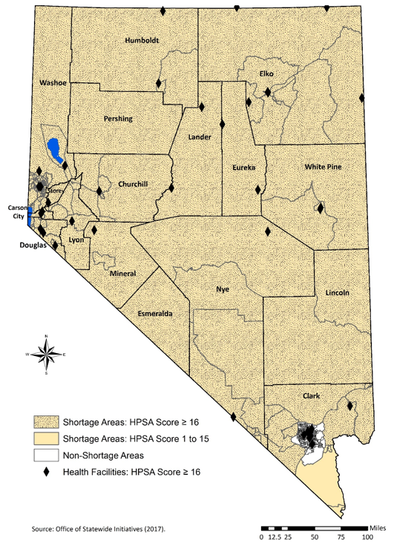
Mental Health Professional Shortage Areas (HPSAs) – 2017
1.5 million Nevadans reside in a mental HPSA (53.3%)
1.2 million urban residents in Nevada (48.1% of urban residents) live in a mental HPSA, including 736,908 residents of Clark County
286,251 rural residents (100.0% of rural residents) live in a mental HPSA
16 single-county mental HPSAs
Notes:
This slide indicates that most of the state is a mental health professional shortage area – urban and rural – and that half of the state’s population reside in a mental HPSA.

Slide 18
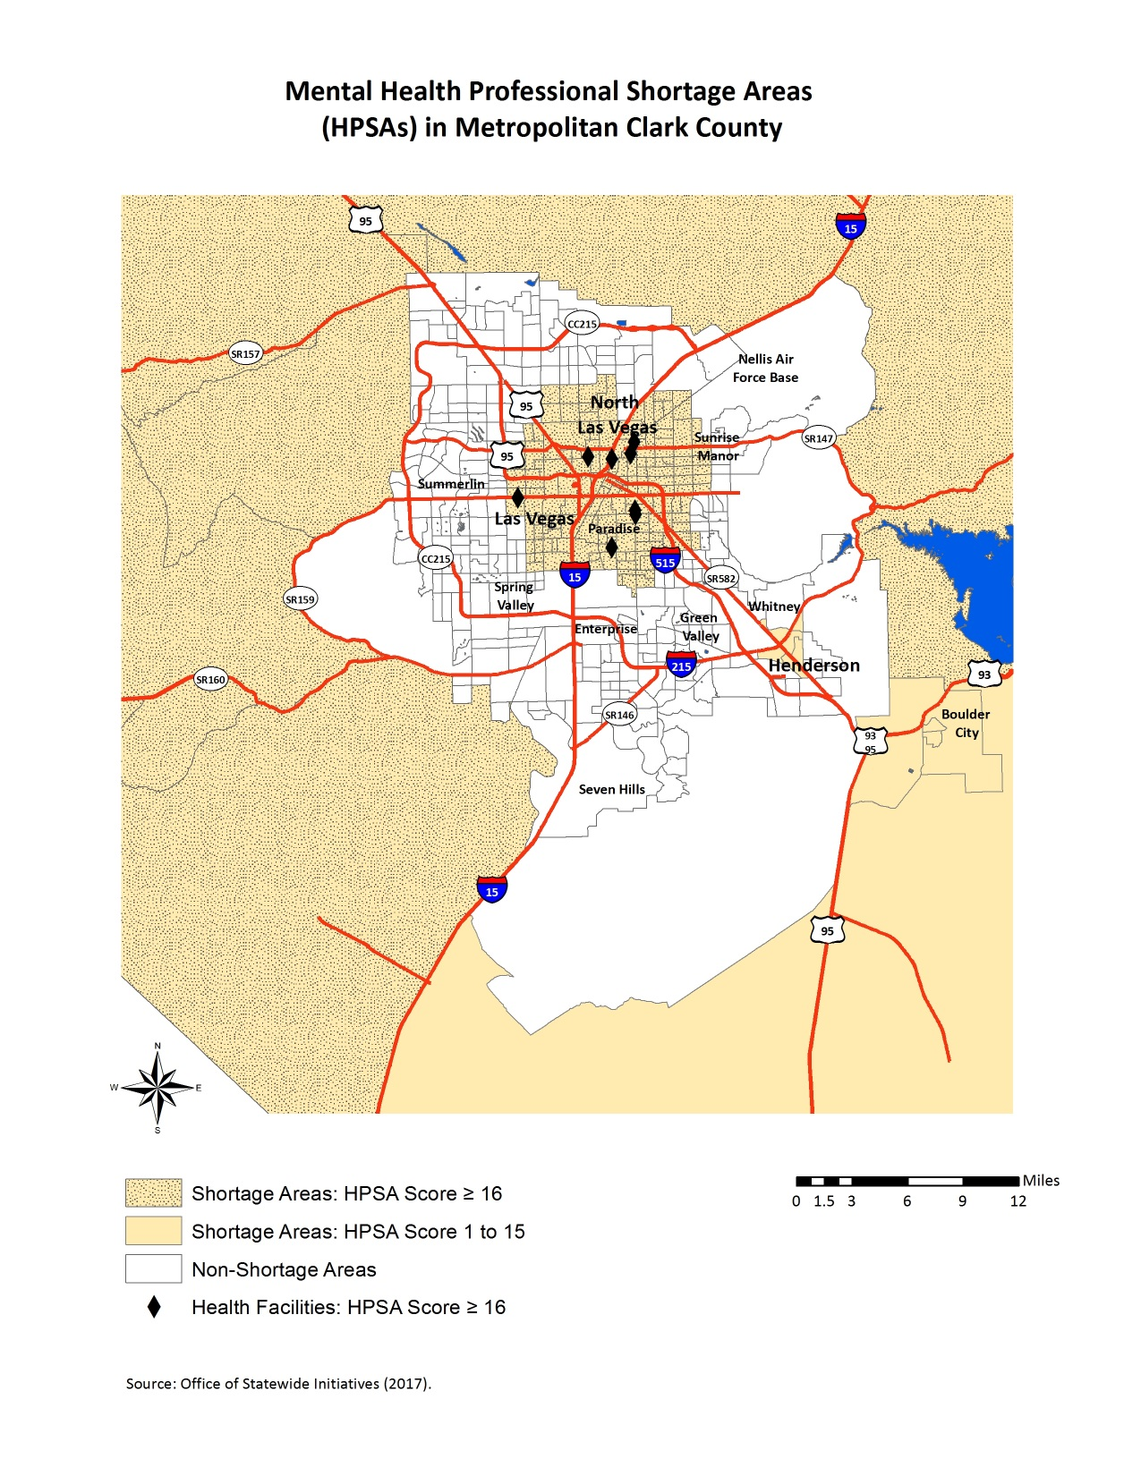
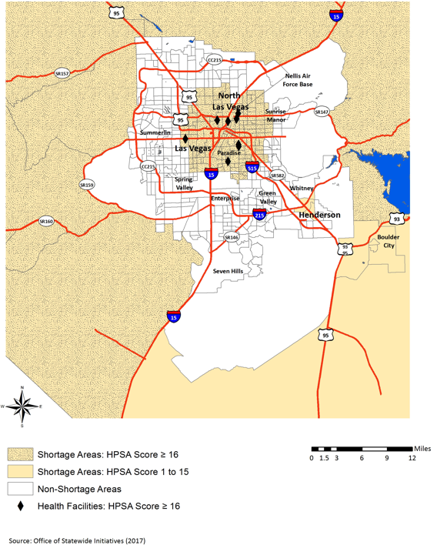
Source: OSI analysis of data from the Health Resources Services Administration (2016).
Notes:
This slide indicates that most of the state is a mental health professional shortage area – urban and rural – and that half of the state’s population reside in a mental HPSA.

Slide 19
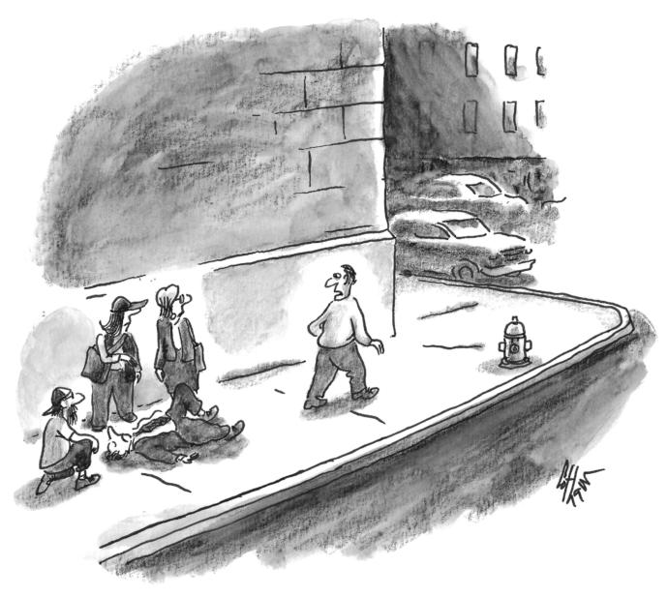
“I’ll go shop around for a doctor.”

Slide 20
UNSOM GME Exit Survey
Annual survey of physicians completing UNSOM residency and fellowship programs since 2004
On-line, 29-item questionnaire administered from May 1 to 31 each year
90%+ response rate (93% in 2017)
Historical and trend data updated via data from the Nevada State Board of Medical Examiners
Future surveys will be administered to UNR, UNLV, and non-NSHE GME program graduates

Slide 21
Retention of Physicians Completing UNSOM GME Programs – 2017
N = 120 | Beginning Practice | Continuing GME or Other | Total
Remaining in Nevada | 32 (26.7%) | 4 (3.3%) | 36 (30.0%)
Leaving Nevada | 47 (39.2%) | 37 (30.8%) | 84 (70.0%)
Total | 79 (65.8%) | 41 (34.2%) | 120 (100.0%)
Source: Griswold & Packham. OSI Annual UNSOM GME Exit Survey (2017).
Notes:
GME survey data since 2004 conducted by UNR, SOM

Slide 22
School of Medicine GME Graduates - 2008 to 2017
Number of Graduates from Southern Programs
Source: Griswold & Packham. OSI Annual UNSOM GME Exit Survey (2017).

Slide 23
School of Medicine GME Retention - 2008 to 2017
Number of Southern Program Graduates Remaining in Nevada
Source: Griswold & Packham. OSI Annual UNSOM GME Exit Survey (2017).

Slide 24
School of Medicine GME Retention - 2008 to 2017
Percent of Southern Program Graduates Remaining in Nevada
Source: Griswold & Packham. OSI Annual UNSOM GME Exit Survey (2017).

Slide 25
School of Medicine GME Graduates - 2008 to 2017
Number of Graduates from Northern Programs
Source: Griswold & Packham. OSI Annual UNSOM GME Exit Survey (2017).

Slide 26
School of Medicine GME Retention - 2008 to 2017
Number of Northern Program Graduates Remaining in Nevada
Source: Griswold & Packham. OSI Annual UNSOM GME Exit Survey (2017).

Slide 27
School of Medicine GME Retention - 2008 to 2017
Percent of Northern Program Graduates Remaining in Nevada
Source: Griswold & Packham. OSI Annual UNSOM GME Exit Survey (2017).

Slide 28
Retention of Physicians Completing UNSOM GME Programs in Nevada – 2008 to 2017
N = 887 | Beginning Practice | Continuing GME or Other | Total
Remaining in Nevada | 409 (46.1%) | 30 (3.4%) | 439 (49.5%)
Leaving Nevada | 307 (34.6%) | 141 (15.9%) | 448 (50.5%)
Total | 716 (80.7%) | 171 (19.3%) | 887 (100.0%)
Source: Griswold & Packham. OSI Annual UNSOM GME Exit Survey (2017).

Slide 29
Current Physician Workforce Supply by Specialty and County in Nevada
Per capita counts versus State average (Table 1)
Clark County: 11 of 36 specialties above state average, including pediatrics and internal medicine
Washoe County: 32 of 36 above state average
Per capita counts versus US average (Table 2)
Clark County: Only 2 of 36 above US average
Washoe County: 18 of 36 above US average
Nevada: Basically all specialties are below US average

Slide 30
OSI Health Workforce Research and Policy Program
Health Workforce Supply in Nevada – regional and statewide supply analysis
Annual survey of physicians completing UNSOM graduate medical education programs
Physician Workforce in Nevada and Nursing Workforce in Nevada reports
Ongoing survey of incoming and graduating nursing students in NSHE nursing programs

Slide 31
OSI Health Workforce Research and Policy Program
http://med.unr.edu/statewide/reports

Slide 32
John Packham, PhD
Director of Health Policy Research
Office of Statewide Initiatives
University of Nevada, Reno School of Medicine
(775) 784-1235
jpackham@med.unr.edu
http://www.med.unr.edu/statewide

